Slide 1
Quick Pricing Guide – Analytics and Reporting Tools
Travis Sondgerath, MS, MPH

Slide 2
Objectives of Slides
Summarize the most popular reporting tools with respect to sought after features and cost
Some of the most popular reporting and analytics tools include R Studio, Tableau, and Microsoft Power BI. Each have server options to publish reports internally as well as externally
R Studio – RStudio Connect
Tableau – Tableau Server
Microsoft Power BI – Microsoft Power BI Server

Slide 3
Feature Summary
 | RS Connect | Tableau | Microsoft Power BI
Push button publishing from desktop software to server | ☑ | ☑ | ☑
Scheduled email alerts to view reports | ☑ | ☑ | ☒
Set reports to email alerts when certain conditions are met | ☑ | ☑ | ☒
Administrative ease | ☑ | ☒ | ☑
Role-based security | ☑ | ☑ | ☑

Slide 4
Cost Estimate
Scenario 1: Want an on premise server to deliver reports to 50 ‘named’ users (‘named’ users - reports are not publicly available, must ‘name’ users so they can be authenticated in order to view reports). You have 2 analysts with publishing rights to create reports. System needs to be capable of sending scheduled reports on a regular basis or when certain conditions are met in the data. Easy administration/organization of reports is a plus.
RStudio Connect (‘Standard’ plan)
Server - $25,000/yr
Named users – ‘Standard’ server comes with 100 named users (‘Base’ has same features for $15,000/yr but only 20 named users). Named users include the analysts publishing reports to the server. Can add additional user packs for $5,000 for 50 or $15,000 for 250.
Desktop software – free. Standard software capable of publishing directly to server.
Cost for scenario - $25,000/yr
Tableau
Server - $10,000/10 named users/year
Desktop software (for report development) – $840/yr/ user (2 users)
Tableau Server (tor managing reports published to server) – $420/yr/user (2 users)
Cost for scenario – $52,520/yr
Microsoft Power BI
Sever - $60,000/yr – unlimited users
Desktop software – free
Pro license (for editing shared reports in server workspace) - $180/yr/user (2 users)
Cost for scenario - $60,360
$100,000
Power BI Server
Tableau Server
RStudio Connect
$0

Slide 5
Cost Estimate 2
Scenario 2: Want an on premise server to deliver reports to 15 ‘named’ users. You have 1 analyst with publishing rights to create reports.
Same general requirements as Scenario 1
RStudio Connect (‘Standard’ plan)
Server - $15,000/yr
Named users – ‘Basic’ server comes with 20 named users
Desktop software – free. Standard software capable of publishing directly to server.
Cost for scenario - $15,000/yr
Tableau
Server - $10,000/10 named users/year
Desktop software (for report development) – $840/yr/ user (1 user)
Tableau Server (for publish reports to server) – $420/yr/user (1 user)
Cost for scenario – $21,260/yr
Microsoft Power BI
Sever - $60,000/yr – unlimited users
Desktop software – free
Pro license (for editing shared reports in server workspace) - $180/yr/user (1 user)
Cost for scenario - $60,180
$100,000
Power BI Server
Tableau Server
RStudio Connect
$0

Slide 6
Conclusions
I have experience using all three of these tools. Each have their own strengths and weaknesses which I summarize below. I would personally recommend RStudio Connect based on price and functionality. Additionally, using Rstudio Connect allows the developer to use the robust statistical tools available in R. Tableau and Power BI have fewer inferential capabilities.
RStudio Connect
Pros – Excellent administrative tools, statistically robust libraries for analysis, easy publishing to server via R Studio, good pricing, cost scales with additional named users, can publish reports to server for unlimited unnamed users (publicly available reports).
Weaknesses – analysts must create reports using R. Although a R is a powerful statistical programming language, the learning curve for this programming language can be steep and requires specific skills.
Tableau
Pros – easy to use drag and drop interface for creating visualizations. Role-based security easy to implement at the report level, software generally picks the best visualization based on the data included in the visualization.
Weaknesses – extremely expensive, each report published to the server must be administered as a stand alone report requiring named users to be added to each report individually.
Microsoft Power BI
Pros – cost efficient, drag and drop interface, although a server is initially expensive the number of users can be scaled infinitely if desired, administration is extremely simple – Power BI is a Microsoft product and integrates well with MS Office Exchange allowing the administrator to use Outlook distribution lists as access groups for reports. Related reports can be bundled together as ‘Apps’ with different access groups specified based on the app being accessed.
Cons – visualizations are limited relative to the other tools available, developing informative reports can be difficult, expensive initially.

Slide 7
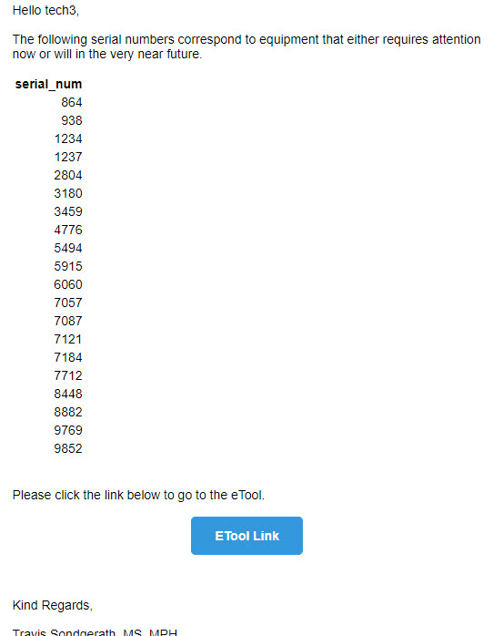
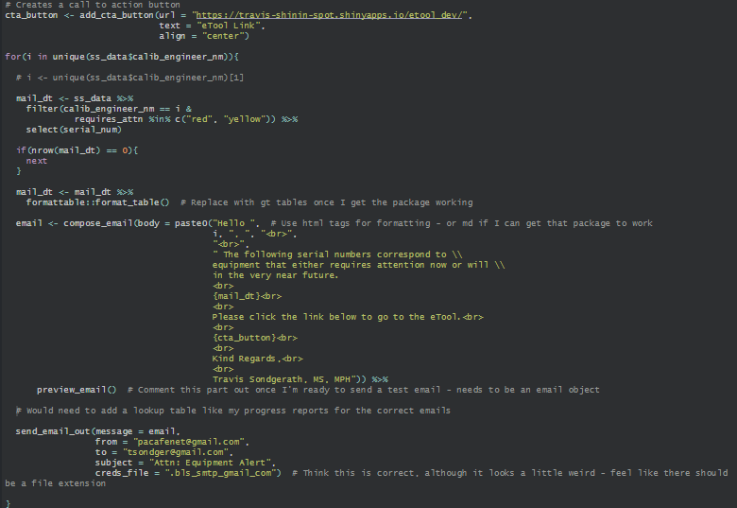
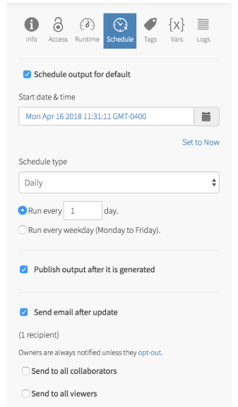
Alternatives to Commercial Software – Custom Solutions
Create custom email that could alert engineers as to what equipment needs work – blue button would take them to the eTool for more details – could be scheduled to run on a regular basis
Example to the left hard coded in R – requires knowledgeable analyst, still requires updating individual email addresses which may change frequently
Whereas commercial products allow the admin to schedule reports easily and even allow the viewers to opt out of future alerts (R Studio Connect example)

Slide 8
Next Steps
Suggest trying the Rstudio Connect Quick Start – available Jan 19th
Quick Start does not require a server to be downloaded
Has all RStudio Connect capabilities including ability to email reports and control admin rights
Free – can try for 45 days
Final note on RStudio Connect – 50% discount available for non-profits with annual operating budget < $10 million/yr (discount applies to server as well as additional named user packs)

